Slide 1
A successful international collaboration CCUS-event Rotterdam 8 June 2022
Ragnhild Rønneberg rr@rcn.no
Coordinator of ACT - RCN

Slide 2
This is ACT
Funding agencies from 16 countries, regions, and provinces collaborating on transnational calls and knowledge sharing within CCUS. Consortium established in 2016 under Horizon2020.
Alberta (Canada)
USA
Denmark
France
Germany
Greece
Italy
The Netherlands
Norway
Nordic countries
Romania
Spain
Switzerland
Turkey
UK
India
Black = countries from the start 2016 Green = new in 2019 Red = new in 2020

Slide 3
Three successful calls
ACT1 – launched 2016
ACT2 – launched 2018
ACT3 – launched 2020
Funding agencies from 9 countries
8 projects funded, started in 2017 (completed Dec. 2020)
36 M€ from ACT of which 12 M€ from EC
Funding agencies from 11 countries
12 projects funded, started autumn 2019 (ending autumn 2022/winter 2023)
31 M€ from ACT, no EC money
Funding agencies from 16 regions/countries
13 projects funded started autumn 2021 (ending 2023/2024)
32 M€ from ACT, no EC money
Present their projects at the ACT knowledge sharing worskhop 9-10 June
www.act-ccs.eu

Slide 4
What ACT has achieved
Paved the way for large scale CCUS deployment
Provided results of relevance to development of Longship, Porthos, Scottish CCUS cluster, etc.
Results complying with the SET plan implementation – and the Mission innovation R&I targets.
ACT project is more than the sum of each national efforts ….
Established collaboration between partners (in Europe and across the Atlantic and to India) who without ACT would not have found each other (not at all or not that easily)
Invited projects to share results with industry and decision makers
ACT as consortium and the ACT project have attended a number of international conferences.
Provided relevant inputs to the CETP (Clean Energy Transition Partnership) and the ACT partners will be strongly engaged in this Initiative.
www.act-ccs.eu

Slide 5
www.act-ccs.eu

Slide 6
ACT4 call launch 12 May 2022
Participating country/region | Funding organisation | Indicative budget
Canada, Province of Alberta | Emissions Reduction Alberta (ERA) | CAD$ 2.85 million
Germany | Forschungszentrum Jülich GmbH, Projektträger Jülich (FZJ/PtJ) | € 3 million
India | Department of Science and Technology (DST), Ministry of Science and Technology, Government of India | € 1 million
Norway | The Research Council of Norway (RCN) | Up to NOK 30 million
United States | Department of Energy (DOE) | US$ 5.4 million (Equivalent to approx. 5 million €)
Broad scope
Industry relevance
Deadline for submission: 12 Sept 2022
One step procedure. Only full proposals
Decision for funding: December 2022
Project to start: spring 2023

Slide 7
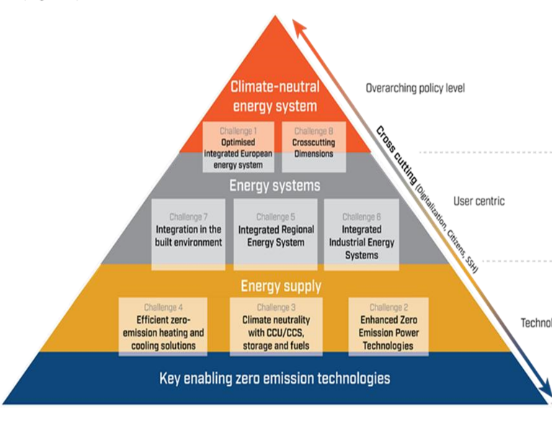
Stepping up European and International climate goals by the CETPartnership - focus areas:
TRI1 Optimised integrated European net-zero emissions Energy System (AT-BMK)
TRI2: Enhanced zero emission Power Technologies (IT-MUR)
TRI3: Enabling Climate Neutrality with Storage Technologies, Renewable Fuels and CCU/CCS (NO-RCN)
TRI4: Efficient zero emission Heating and Cooling Solutions (NL-RVO)
TRI5: Integrated Regional Energy Systems (AT-BMK)
TRI6: Integrated Industrial Energy Systems (FI-BF)
TRI7: Integration in the built Environment (ES-AEI)

Slide 8
TRI3 – scope Lead: RCN, Ragnhild Rønneberg Co-lead: SWEA, Aiko Nylander and FCT, Isabel Cabrita Main Partners for the implementation: PtJ/Julich-DE RVO-NL Rannis-IS MUR-It TR- ČR Call launch: September 2022
The main aim is to provide technological cleaner solutions for renewable based fuels and CCS (Carbon Capture and Storage) and CCU (Carbon capture and Usage), promoting RD&D and innovation projects until 2030, to achieve the European goal of climate neutrality by 2050.
Utilisation of a wide range of energy vectors, in particular hydrogen and renewable fuels, as well as hybrid solutions are expected to support cross-sectoral integration. Appropriate liquids and gases, fuel and chemicals technologies will serve flexibility and sector coupling needs in the energy system, and are important enablers for sector integration, as in industry or transport.
CCU/CCS technologies need to be upscaled and deployed to maximise carbon reuse in a circular economy and to remove carbon from the energy system, in particular from hard-to-decarbonize sectors to ultimately deliver negative emissions and to strengthen sector integration with industry.

Slide 9
Thank you for your attention !
Ragnhild Rønneberg, rr@rcn.no

